Slide 1

PowerShell User Group
Southampton 20/06/2018
@PSSouthampton

Slide 2
agenda!
7.00pm - Arrival
7.30pm - Welcome / User Group Introduction - @jonathanmedd
7.35pm - Part 1: GitHub 101 - an intro to GitHub - Chris Murray - @chris18890
8.15pm - Break / Refreshments
8.45pm – Part 2: Introduction to PowerShell Module Development - Jonathan Medd - @jonathanmedd
9.30pm - Wrap up / Close

Slide 3
Welcome and Practicalities
Fire exits
Respect our hosts
Deposit and Public Liability Insurance is on me
THANK YOU!

Slide 4
User Group
Aim to meet roughly every 1 – 2 months
We have met every month Jan - Jun
July – social meetup TBD
August – no meeting
Sep / Oct / Nov – back to normal

Slide 5

Welcome new SPONSOR DevOpsGuys!

Slide 6
Want to present?

Slide 7
We need!
Speakers
Some lined up, discussions ongoing
Topic ideas – we need to know what you want to hear about
GitHub 101
Azure PowerShell 101
PowerShell DSC

Slide 8

PSDAYUK 10th Oct 2018 – https://psday.uk

Slide 9
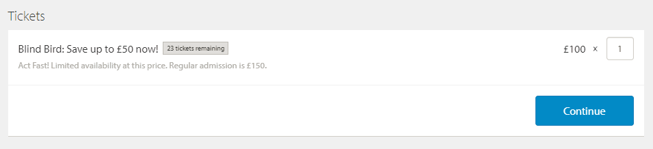
PSDAYUK 10th Oct 2018 – https://psday.uk
Last year’s content here:
https://www.youtube.com/playlist?list=PLLKI4jlvx_95iTr-0egDKiTCKCChnUTTW

Slide 10

Communication
Meetup.com - https://www.meetup.com/PowerShell-Southampton
Twitter - https://twitter.com/PSSouthampton
Slides and content will appear here: https://github.com/powershellorguk/SouthCoast

Slide 11
RSVP Please

Slide 12
Who’s hiring?

Slide 13
Hurry up and move on!

